Slide 1
Navigating EDI
Amy Hurford, CAIMS meeting, June 15, 2022
Slides are available at
https://github.com/ahurford/EDI-resources
Click the link under the heading CAIMS activities

Slide 2
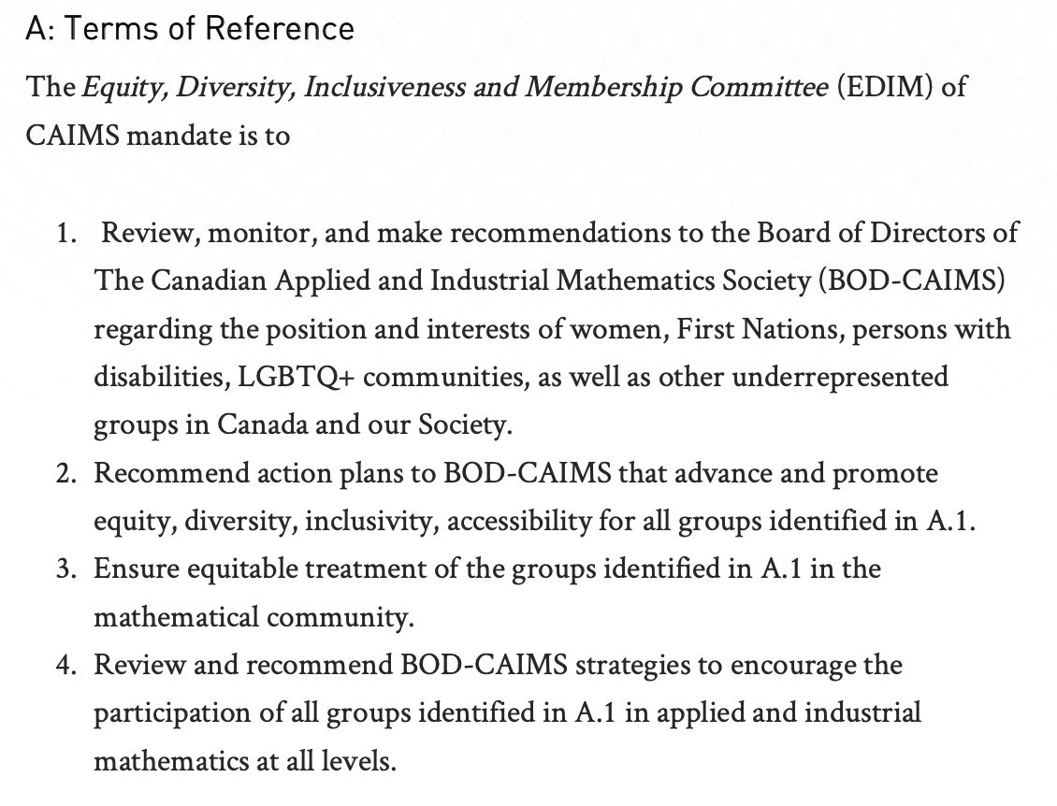
CAIMS EDIM committee

Slide 3
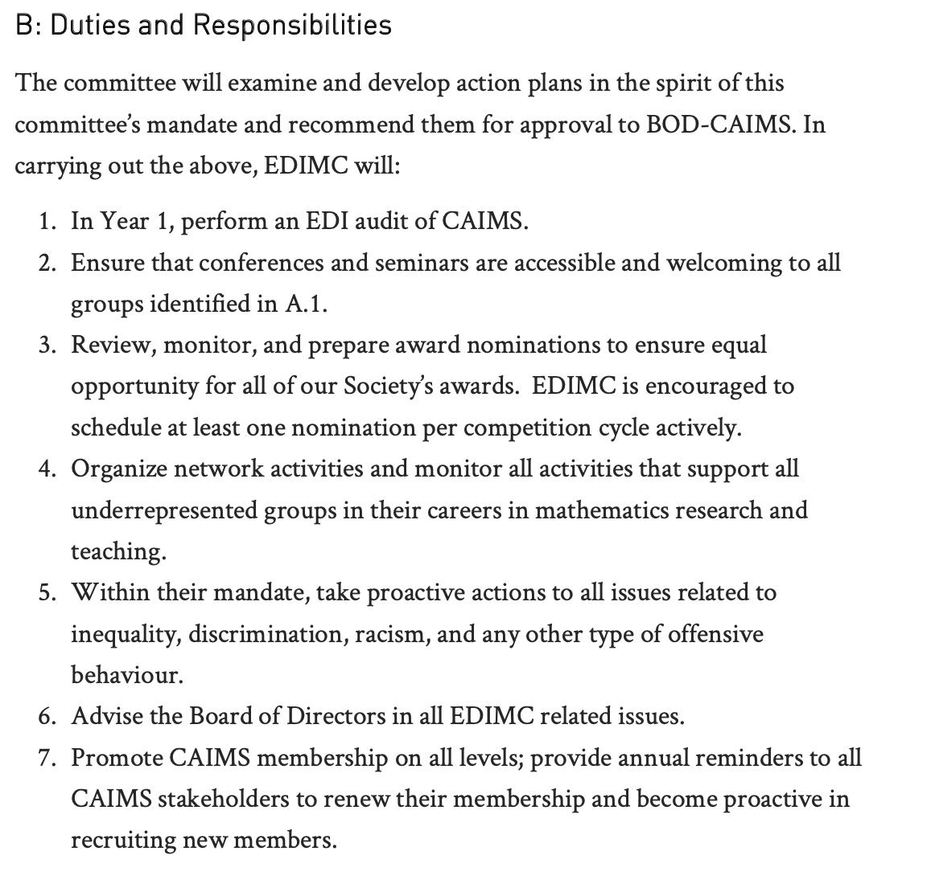
CAIMS EDIM committee

Slide 4
Goals of today’s discussion
Start the conversation
Articulating the need for EDI in science
Share our ideas for what should be done
To be an ally, elevate the voices of under-represented groups
Under-represented groups are exposed to vulnerability when participating in group activities such as this

Slide 5
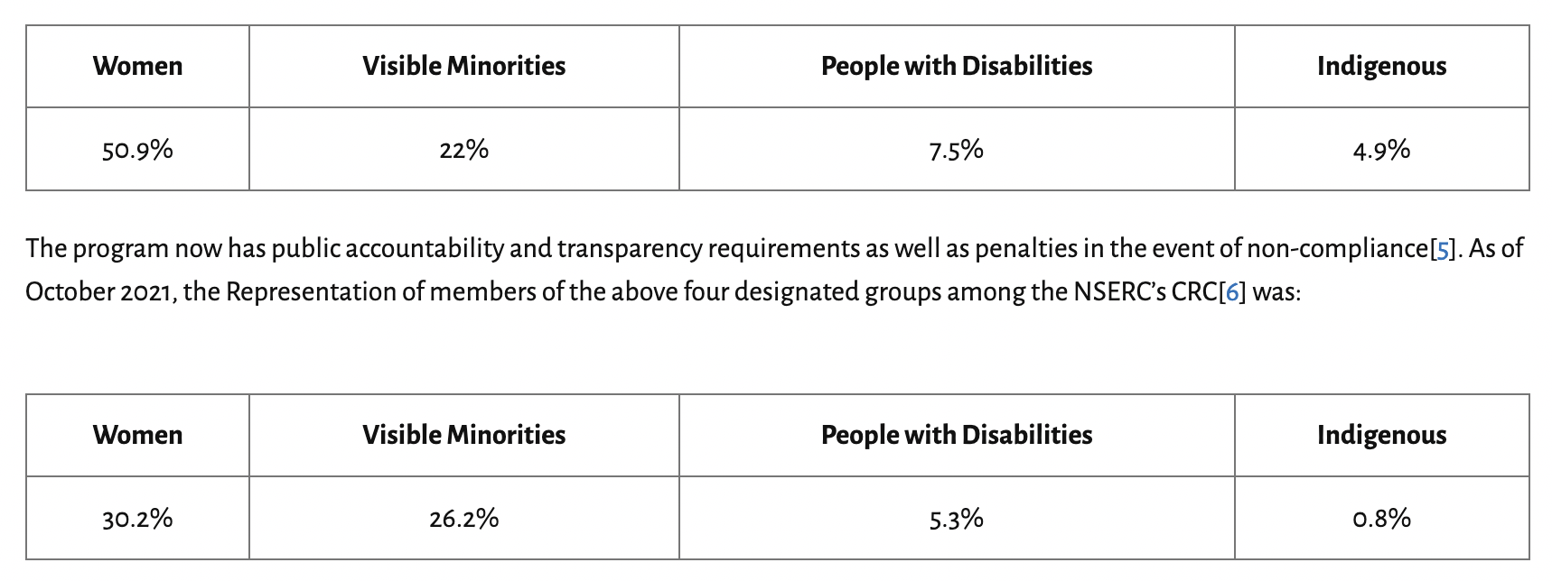
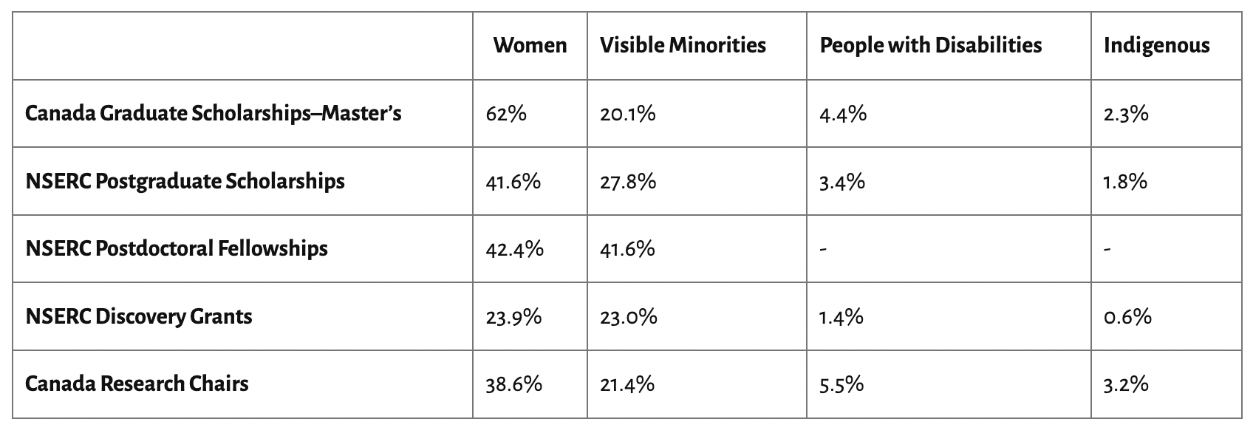
Diversity data for NSERC awards
About the necessity of collecting data to improve EDI in mathematics. CMS

Slide 6
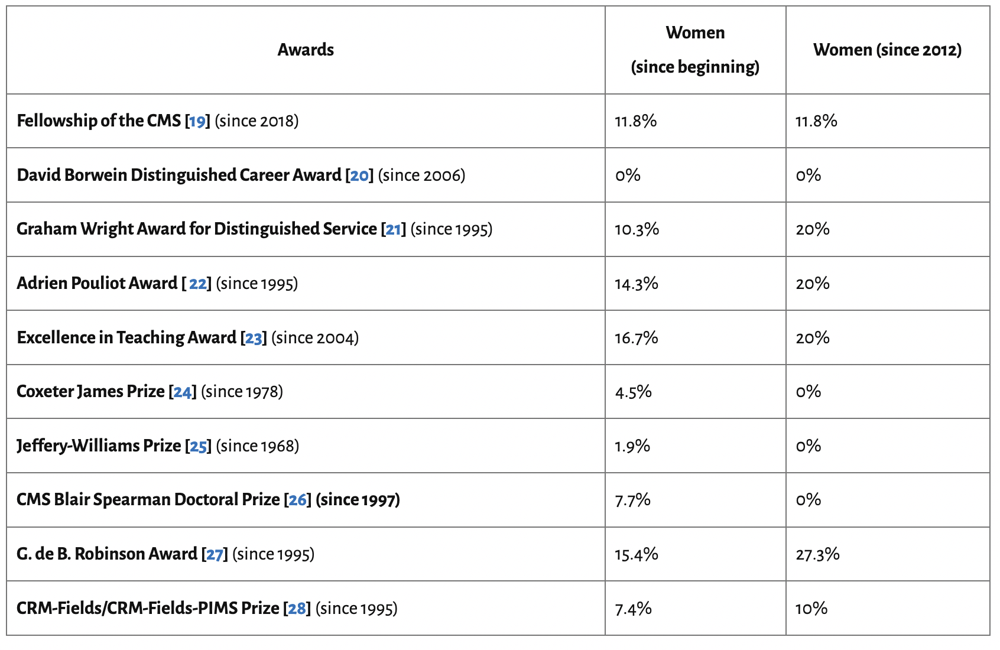
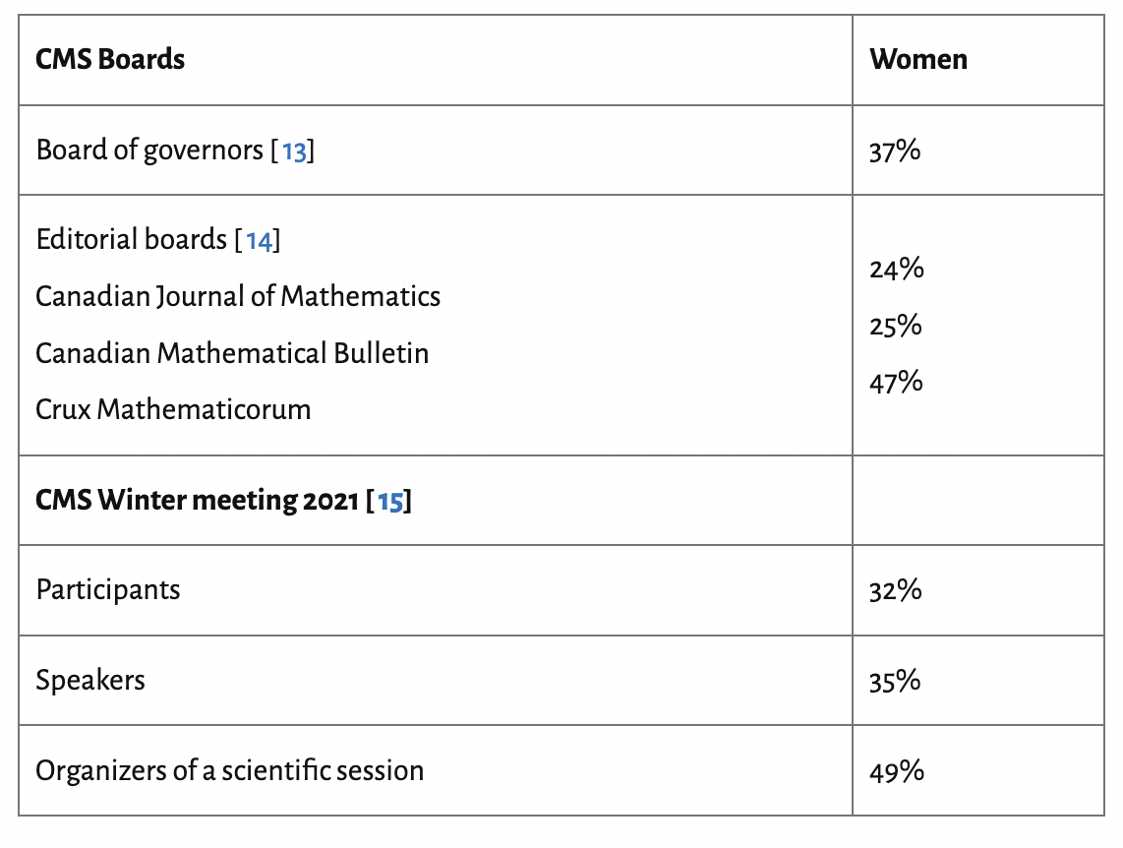
Diversity data for CMS
About the necessity of collecting data to improve EDI in mathematics. CMS

Slide 7
Mathematics
The mathematical community is especially keen on meritocracy and on avoiding the stigma associated with measures such as quotas.
But assessing merit is itself not an exact science
“I truly believe that it’s a really lazy excuse to say ‘we’re just awarding excellence’.” says Jess Wade, a materials scientist at Imperial College London
Mathematics prizes have a gender problem — can it be fixed? Nature May 27 2022

Slide 8
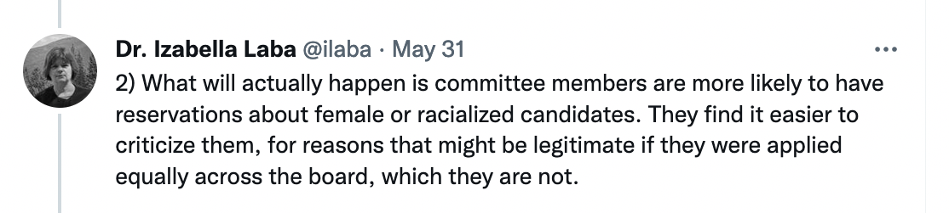
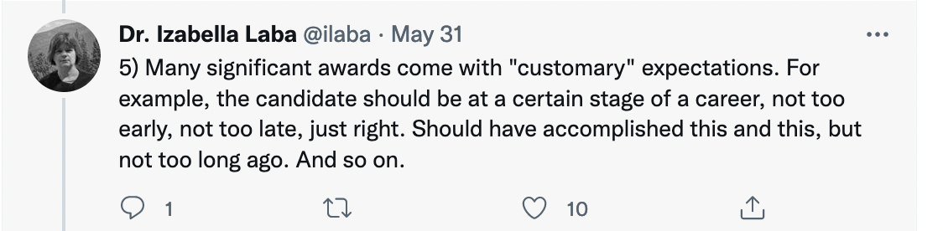
Canada Research Chairs program quotas
(i.e. we awarded in this subdiscipline last year)

Slide 9
The argument for diversity in science
Diversity is critical to excellence
scientific breakthroughs are misattributed to individuals
groups outperform individuals
progress is incremental
progress usually comes from seeing the problem differently
Lack of diversity represents a loss of talent
Enhancing diversity if the key to long-term economic growth and global competitiveness
A genuine assessment of potential would favor an under-represented candidate
Diversity in STEM: What It Is and Why It Matters. Scientific American

Slide 10
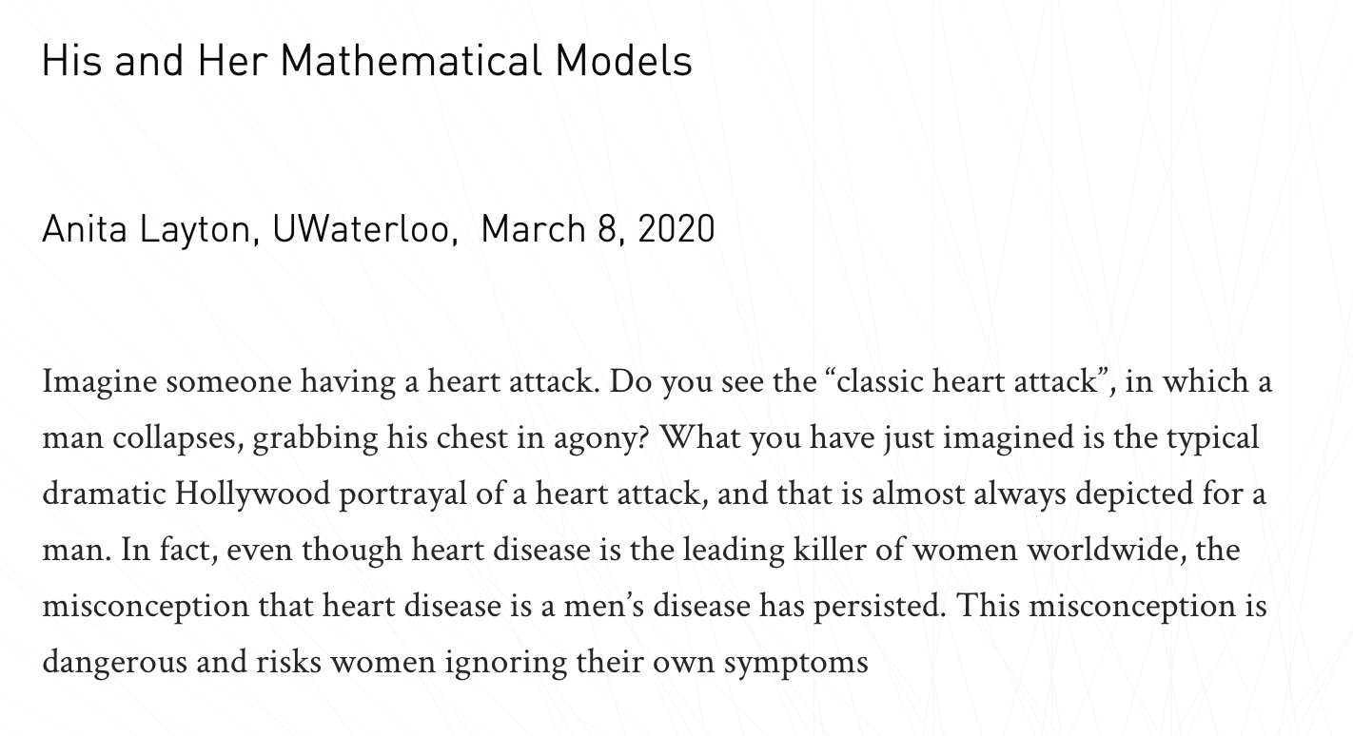
The argument for diversity in science
https://caims.ca/caims-blog/his-and-her-mathematical-models/

Slide 11
Being educated is everyone’s responsibility & why it matters
Assessment rubrics for hiring and awards
Fair appraisal of contributions
Support for EDI initiatives in the workplace
Understand how to do your job in an equitable and inclusive way

Slide 12
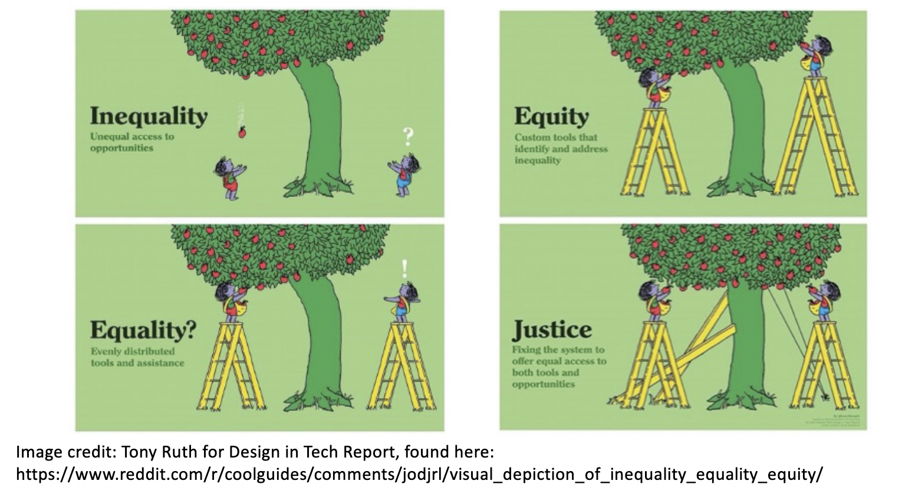
Equity and Justice

Slide 13
EDI work is not about box checking
Overall, we’ve heard in consultations and from some governing bodies that groups are tired of shallow consultations and research projects that do not use results to act in ways that benefit communities (consultations and projects that “go nowhere” and “just check a box”)
https://www.mun.ca/research/Indigenous/faq.php

Slide 14
Summary
Need to collect data
Everyone needs to be educated
Need for co-ordination
Take action

Slide 15
Discussion questions
How do you answer these questions on your NSERC Discovery Grant application?
What actions are needed to achieve the EDI goals for the CRC program?
How do we do research with Indigenous groups ‘in a good way’?
Have you tried to decolonize your syllabus/ knowledge of historical contributions?
How do we support anti-racism in science?
Gender bias in science is well-documented, but the bias continues. What actions are needed?
What actions are needed to support LGBT+ scientists
What actions are needed to support disabled scientists

Slide 16
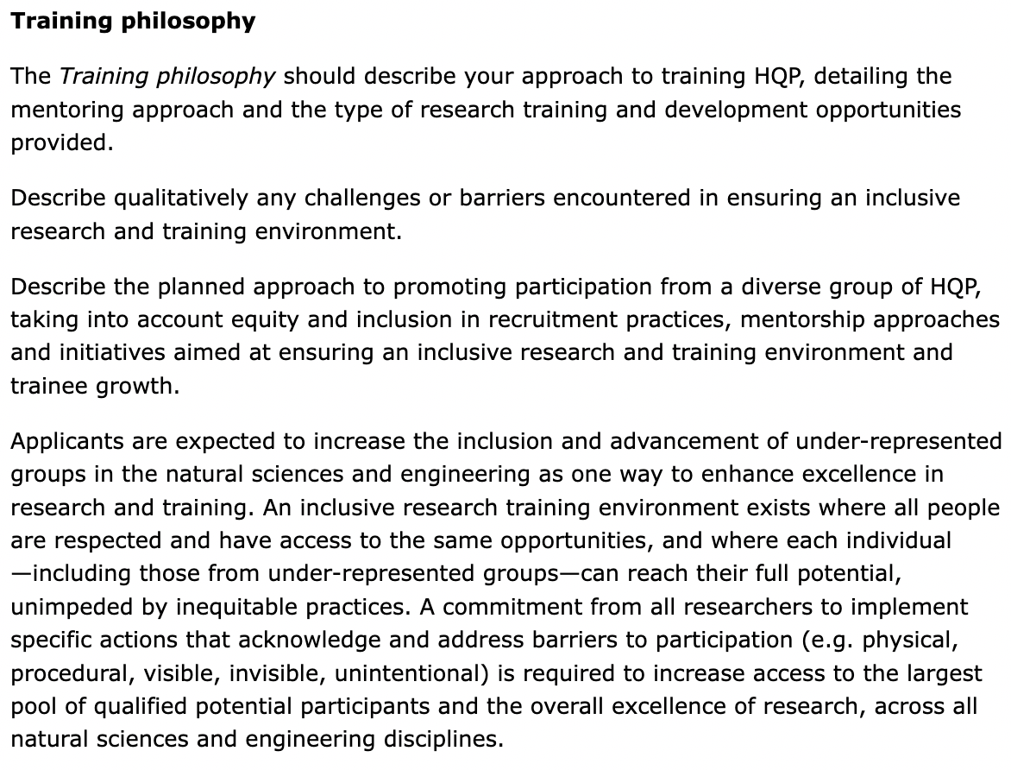

Canadian scientists need to support Equity, Diversity, and Inclusion

Slide 17
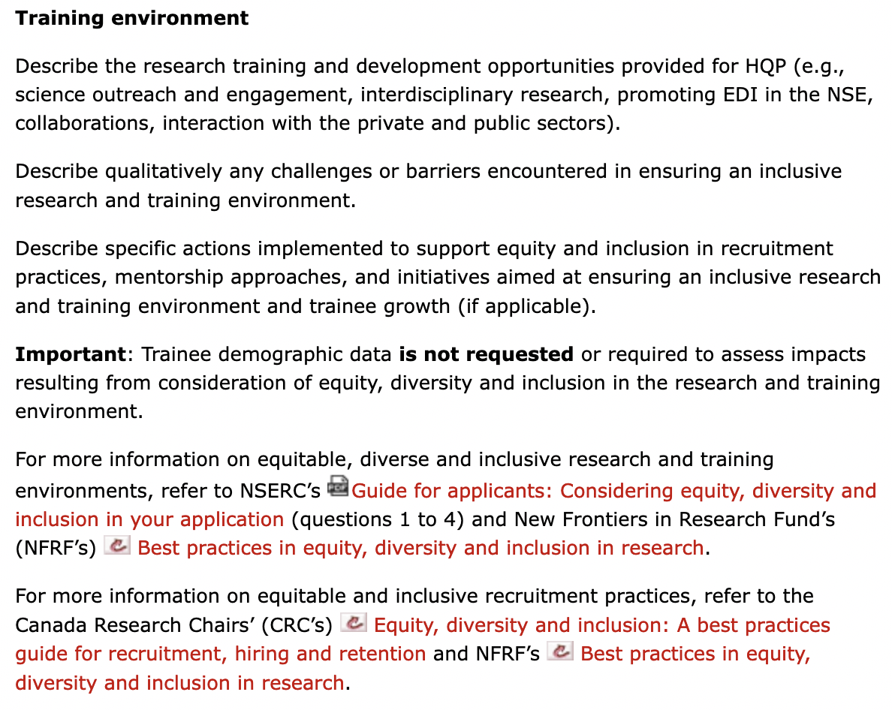
NSERC Discovery Grant requirements

Slide 18
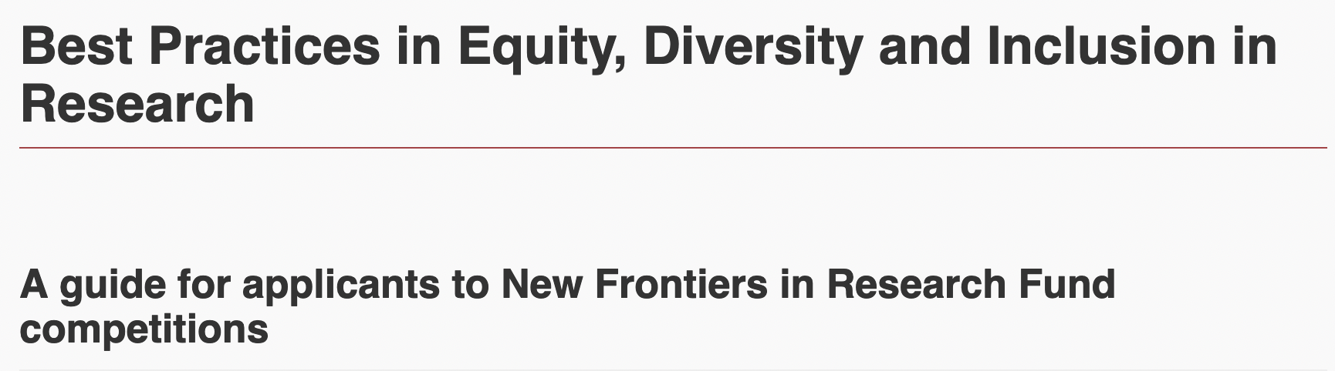
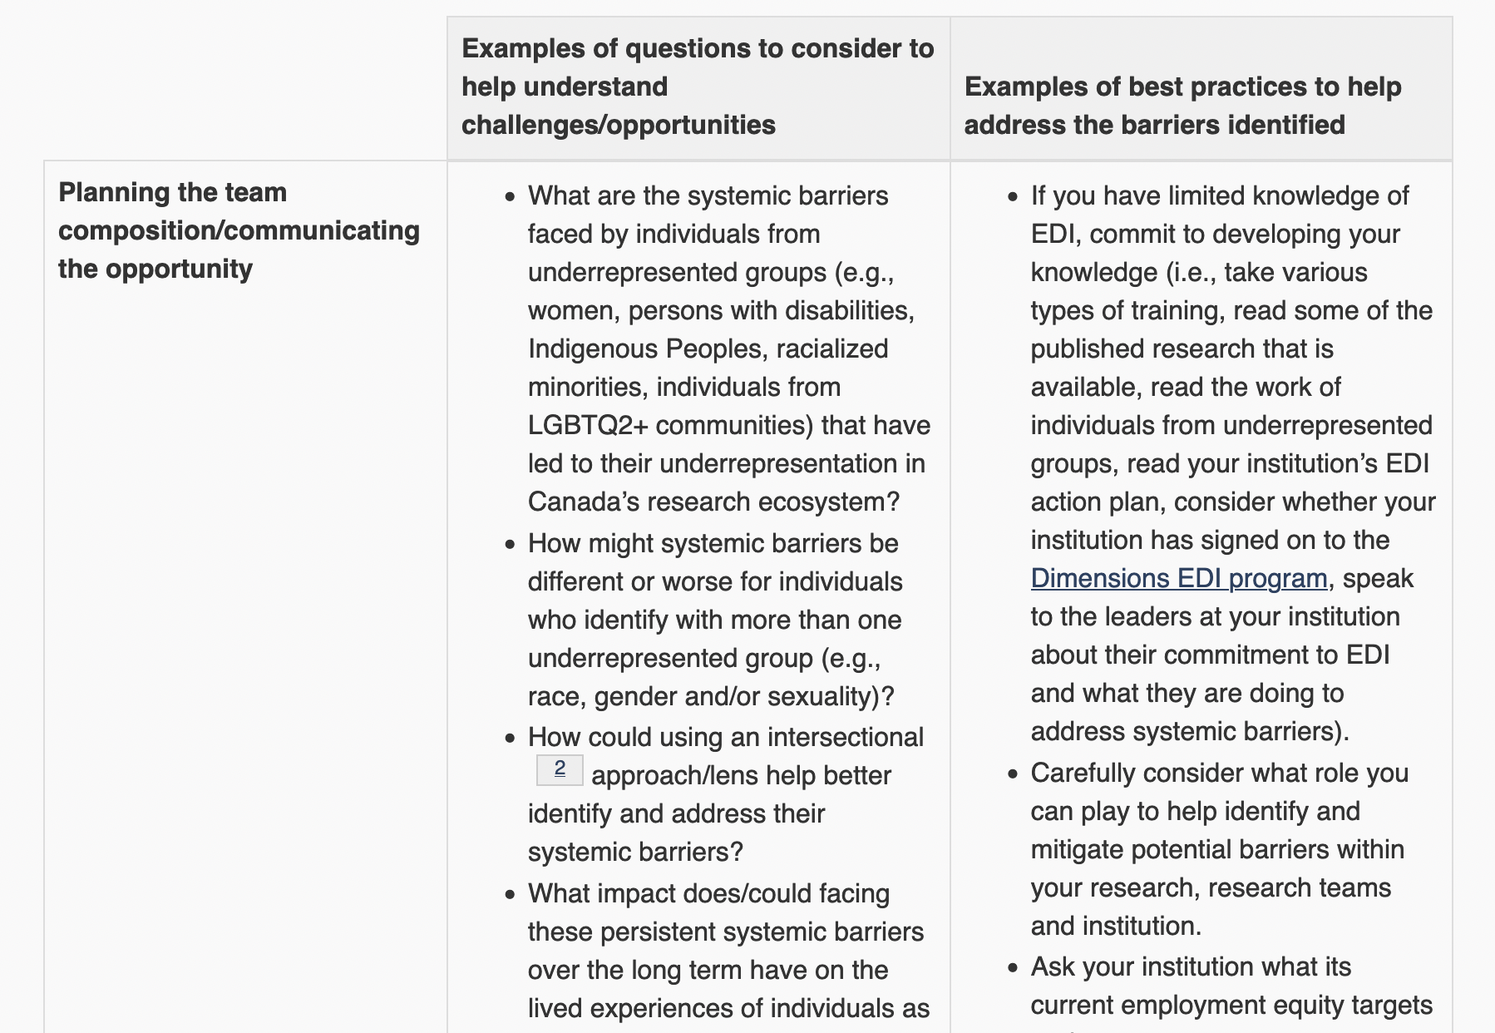
NSERC Discovery Grant recommended resources
https://www.sshrc-crsh.gc.ca/funding-financement/nfrf-fnfr/edi-eng.aspx

Slide 19
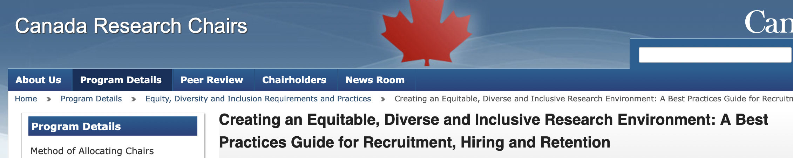
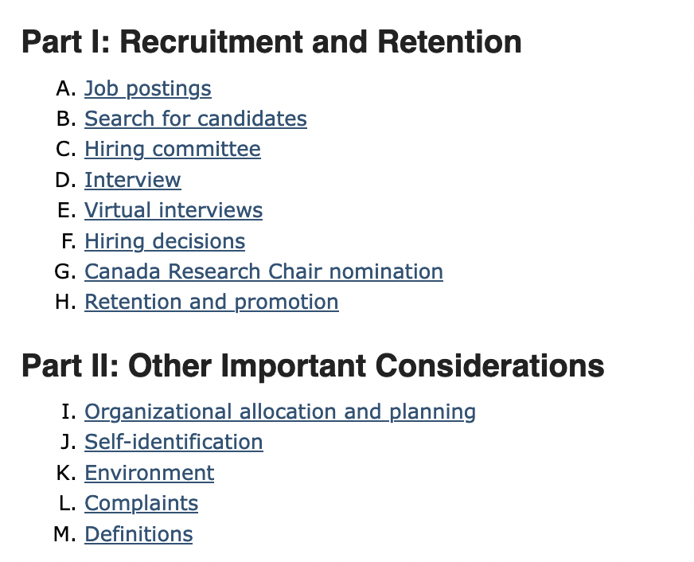
NSERC Discovery Grant recommended resources

Slide 20
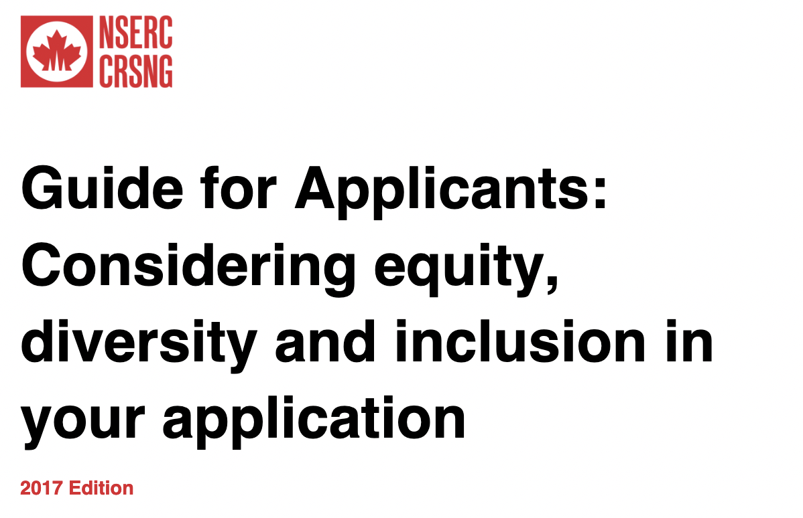
NSERC Discovery Grant recommended resources
What are the benefits of increasing the participation of under-represented groups among co-applicants, collaborators and trainees?
Why is equitable mentorship for all trainees needed (what are the issues/problems and benefits)? What does it mean to provide equitable mentorship?
What is an equitable and inclusive research and work environment (what are the issues/problems and benefits)? What measures can be taken to ensure this is achieved?
How can diversity and equity be highlighted in networking and leadership training events?

Slide 21
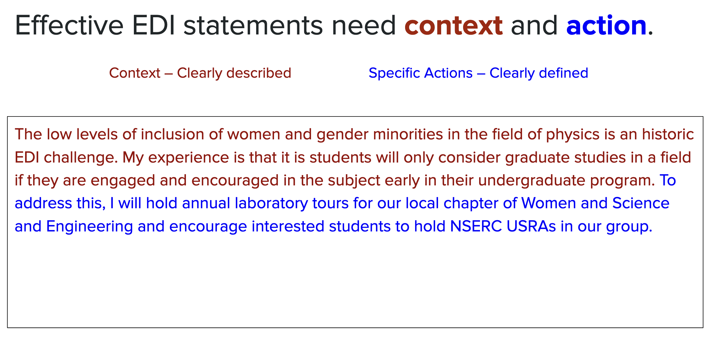

Slide 22
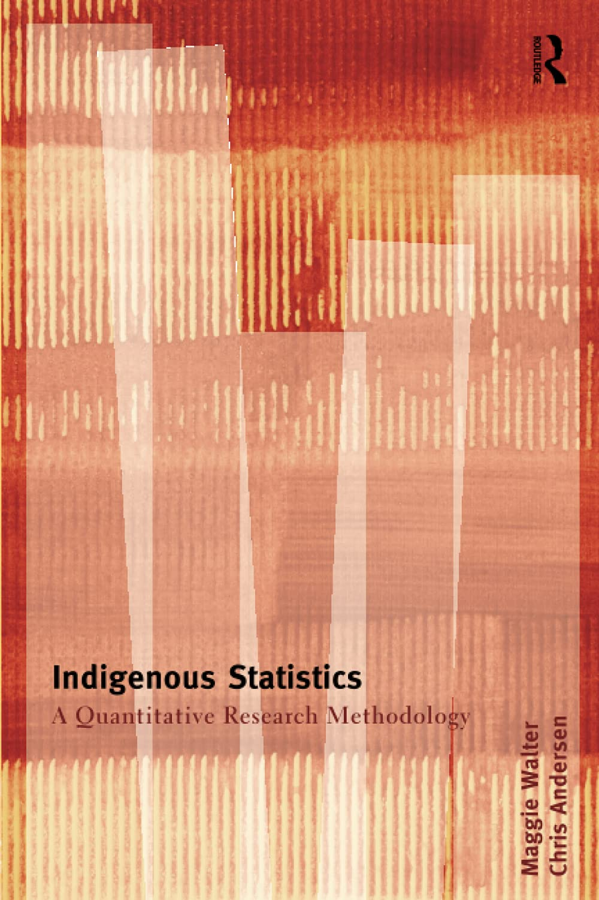
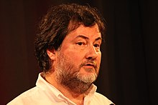

Decolonize your syllabus/HQP training
Require historical essays highlighting less known contributions by under-represented groups
Ross Ihaka Alongside Robert Gentleman, he is one of the creators of the R programming language.^{[4][5][6]} His thesis was on statistical modelling for seismic interferometry and was titled Rūaumoko, after the god of earthquakes, volcanoes and seasons in Māori mythology
Ihaka is of Ngāti Kahungunu, Rangitāne and Ngati Pākehā (New Zealand European) descent.
https://en.wikipedia.org/wiki/Ross_Ihaka

Slide 23
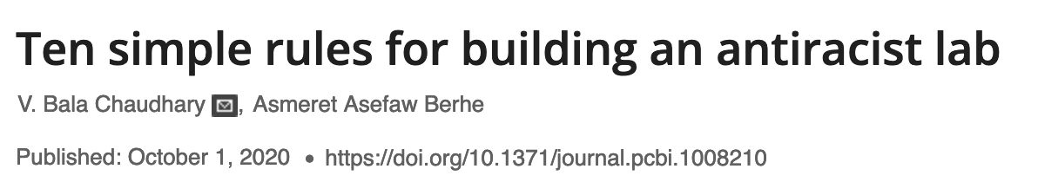
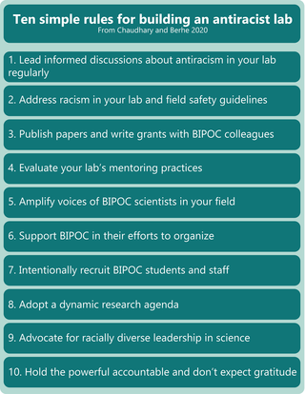

Slide 24
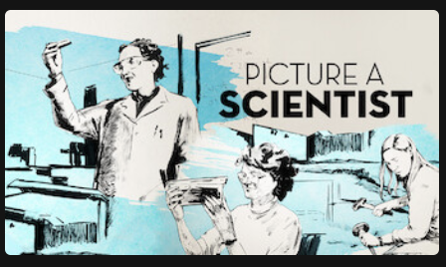

Gender bias in science
We can’t afford to lose 50% of the best people [1:14:34]
Our implicit biases associate men and science [50:35]
Most common forms of sexual harassment are not sexual advances [17:58]
Change is slowed by gaslighting & isolation [38:47]
Advocacy efforts from necessity rather than choice [1:29:54]
Women who speak up leave academia [1:02:29]

Slide 25
LGBT+
Break with convention
Science must adapt
Be inclusive by including
Practice pronouns
Create a support network
We need more role models
How LGBT+ scientists would like to be included and welcomed in STEM workplaces
https://www.nature.com/articles/d41586-020-02949-3

Slide 26
LGBT+
Feel invisible: cloaking an important part of their identity at work can have dangerous consequences for mental health and career advancement
30% of LGBT+ scientists and half of transgender scientists said that they had considered leaving their workplace because of an unfriendly or hostile climate or because of discrimination

Slide 27
1. Break with convention
For example, when I asked questions to engage my classes, some students complained to the dean’s office that I did not know the material. They thought I was asking them questions because I needed their help solving the equations. I wish the school had expressed more confidence in my qualifications — why they hired me in the first place — when they addressed the students’ concerns – Hontas Farmer

Slide 28
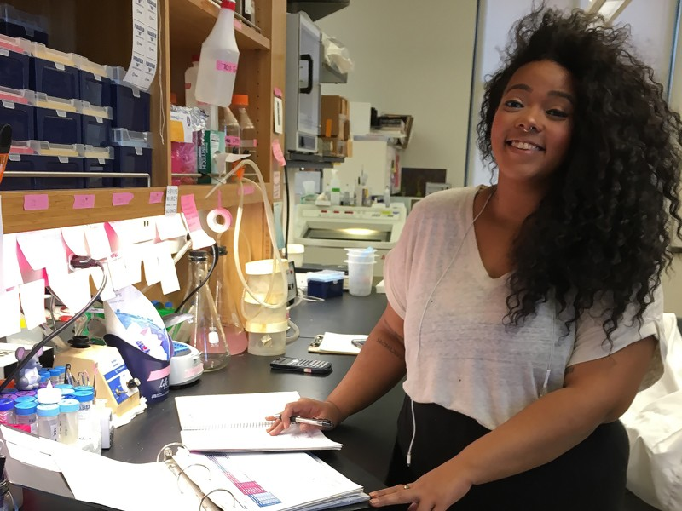
2. Science must adapt
A professor once brought up my queerness in class as a deficit in my cognitive processing. It was so jarring, so shocking. One of my peers spoke up and said, “That is incredibly rude, disrespectful and inaccurate — and has no place here.” The tone of the class shifted dramatically and it got super quiet. The professor tried to backtrack, but was also firm in his conviction that he was right. – Kaela Singleton

Slide 29
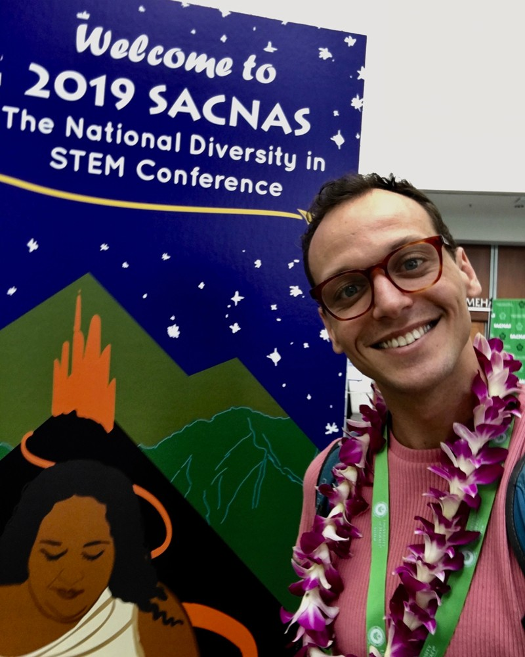
3. Be inclusive by including
I started in the field of ionic liquids soon after I’d first come out as gay in 1984. Our field’s leader then, the now-late Ken Seddon, was quite prepared to make judgements about my research, but did not allow pre-judgement or prejudice about my sexuality. He very clearly demonstrated that he respected me because of the quality of my work and that everything else was secondary. Having the field’s big-wig demonstrate that concept was very helpful. – Tom Whelton

Slide 30
4. Practice pronouns
Two-spirit is a culturally acknowledged third form of gender identity for Native Americans. It encapsulates various forms of sexuality and gender identity — trans, queer, non-binary — as well as the spiritual roles and presentation people can take within their tribes. Two-spirit individuals sometimes have mediating roles between men’s and women’s roles. Or they might have unique functions in cultural practices: those associated with maintaining harmony, menstruation and spirituality, such as being a shaman, or healer, or in the arts, including basket-weaving and dance.– Micah Savin
5. Create a support network
I stopped having to waste emotional energy. I work harder now, and I’m a better teacher. I’m open with my students about my own struggles with physics and that I make mistakes. - JJ Eldridge

Slide 31
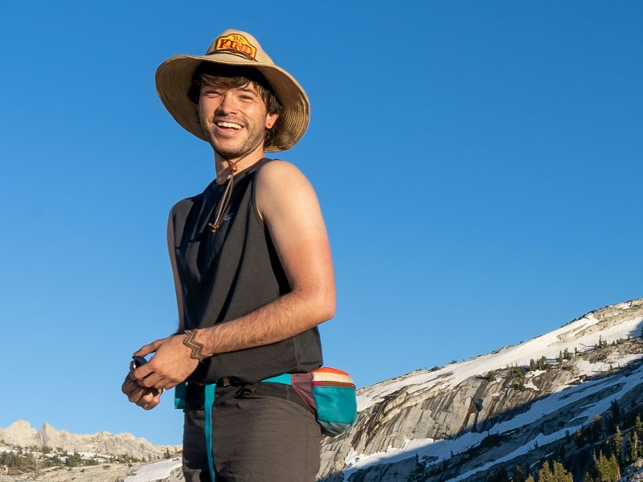
6. We need more role models
If another PI, student or labmate says something inappropriate or offensive, it is important for those in leadership positions to approach them about the situation, even if it’s uncomfortable. Ideally the person will take it as constructive feedback and not as a personal attack. This kind of scenario requires mindful deliverance, so effective communication is key. Irrespective of your role, it is essential to read the situation at hand — if a direct approach doesn’t seem like the best choice because it might throw a spotlight on the victim, then consider other avenues. Reach out to friends, colleagues or fellow LGBT+ students, or student services, for advice on how to move forward. - SEAN VIDAL EDGERTON

Slide 32
Disabilities
Don’t make assumptions
Create equity for all
Disability isn’t a dirty word
Just ask what we need
https://www.nature.com/articles/d41586-021-02907-7

Slide 33
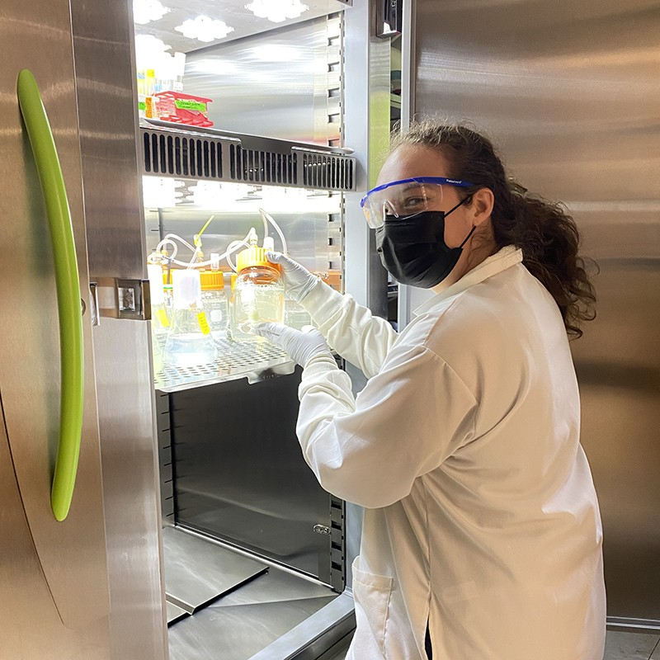
1. Don’t make assumptions
My current adviser is incredibly supportive of people taking time off to deal with their health. I get called out for not scheduling a holiday. Leaves of absence should be normalized. My advice to others is: you don’t know what’s going on with other people. Don’t assume someone is being lazy or doesn’t care.
- Sara Riveria

Slide 34
2. Create equity for all
Some people think that a disability is somehow a privilege, but in reality disabled students need equity — not equality.
With equality, we are not getting anywhere. But with equity, all students can access the same facilities and education.
We cannot give up, even though it’s hard sometimes. I won’t be quiet. Disabled people are part of society, and disability is just another human characteristic. - VANESSA CRISTINA DA SILVA FERREIRA

Slide 35
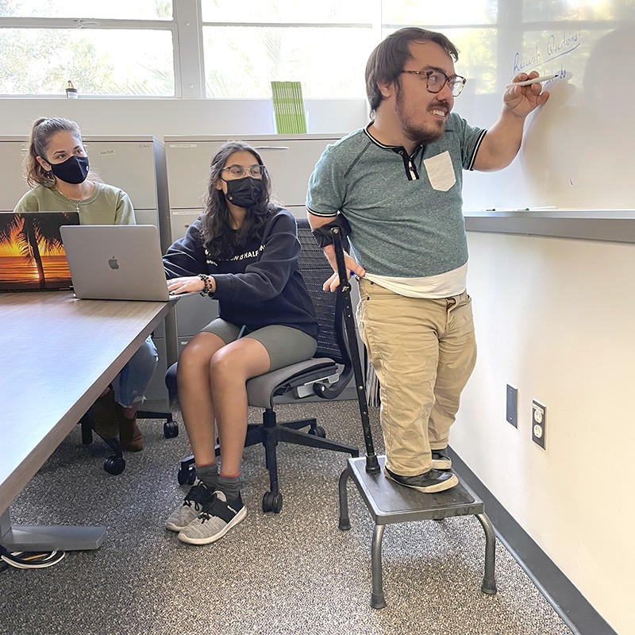
3. Disability isn’t a dirty word
In the end, the costs of my accommodations were shared by my advisers and my department, because they wanted me to be successful. What I needed was inexpensive, but other adaptive equipment could be pricey. If principal investigators think it has to come out of their budget, are they going to want to recruit and retain graduate students with disabilities?
Checking in about accessibility needs should be a lab-group norm, not a special circumstance. Society is finally at the point where ‘disability’ isn’t a dirty word, but we need to frequently discuss accessibility. – Logan Gin

Slide 36
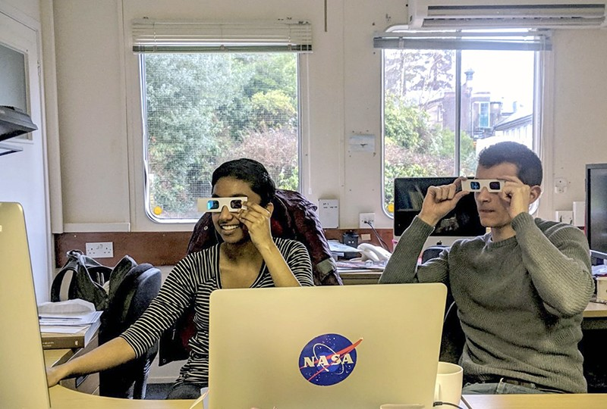
4. Just ask what we need
If you want to advocate for a disabled peer, just ask what they need. It will be awkward, but that’s life. Don’t stop asking your disabled friends to go out. Don’t do things out of kindness without asking for consent. Don’t ever disclose someone’s disability to someone else – Divya Persaud

Slide 37
Resources
https://github.com/ahurford/EDI-resources
Please email ahurford@mun.ca with suggestions of how the EDIM committee can best serve CAIMS

